Slide 1
Medium Access Control Protocols and Local Area Networks
LAN Bridges

Slide 2
Reference
Leon Garcia – 6.11

Slide 3
Introduction
There are several ways of interconnecting Networks
When two or more networks are interconnected at the physical layer the type of device is called as a repeater.
When two or more devices are interconnected at the MAC layer or data link layer, the type of the device is called as a bridge
When two or more devices are interconnected at the network layer, the type of the device is called as a router
The device that interconnects at higher level is called as gateway, which generally performs some protocol conversion and security functions
Notes:
Range extension is the problem – use repeaters.
Amount of activity ( traffic) , collision domain – use bridges(segments the network). – bridged lan.

Slide 4
Why do we need Bridges
Let us consider a scenario in which a large organization has multiple departmental LAN.
After a certain period of time, a requirement arises in the organization to interconnect the departmental LAN in order to share the resources. But this scenario is complicated by the following factors:
The departmental LANs use different network layer protocols.
The departments may be located in different buildings
The LANs differ in type

Slide 5
These three requirements can be supported by bridges.
As bridges exchange frames in the data link layer, the frames can contain any network layer packets
If necessary the bridges can be connected by point to point link.
Bridges also support frame conversion thus supporting intercommunication between different LANs.
Notes:
Security issues
Promiscuous mode of NIC
Bridges – filters the packet -- security

Slide 6
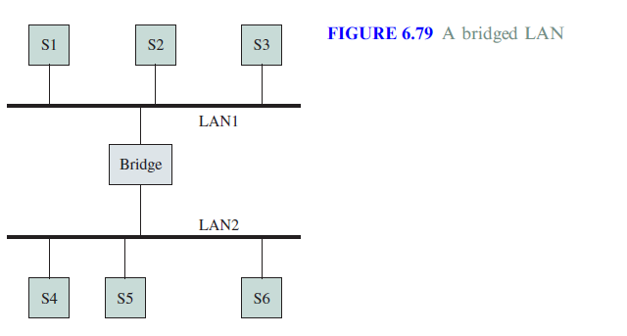
Thus Bridges are used for connecting multiple LANs as shown in the figure.
Bridged LAN or Extended LAN
Notes:
To have a frame filtering capability, a bridge has to monitor MAC address of each frame.

Slide 7
Bridges of Same Type
Network
Network
LLC
Bridge
LLC
MAC
MAC
MAC
MAC
Physical
Physical
Physical
Physical
Bridging is done at MAC level thus operating in the data link layer
To have frame filtering capability , a bridge has to monitor MAC address of each frame.

Slide 8
Types of Bridges
There are two types of bridges which are widely used:
Transparent Bridges: These bridges are widely used in Ethernet LANs
Source Routing Bridges: These bridges are widely used in Token Ring LANs and FDDI networks

Slide 9
Transparent Bridges
These bridges were defined by the 802.1d committee.
The term transparent refers to the fact that the stations are completely unaware of the presence of the bridges in the network
Thus introducing a bridge doesn’t require the stations to be configured.
Following are the functions of the transparent bridges:
Forward Frames from one LAN to another
Learn which stations are attached to a given LAN
Avoid Loops in the topology

Slide 10
Bridge Learning
When frame arrives on one of the ports of the bridge, the bridge has to decide whether it has to forward the frame.
To do so it needs to maintain a table called as the forwarding table or forwarding database
Use table lookup, and
discard frame, if source & destination in same LAN
forward frame, if source & destination in different LAN
use flooding, if destination unknown
Use backward learning to build table
observe source address of arriving LANs
handle topology changes by removing old entries
Notes:
Backward learning : tables at each bridge gets modified by information from the incoming packets

Slide 11

S1
S2
S3
S4
S5
LAN1
LAN2
LAN3
B1
B2
Port 1
Port 2
Port 1
Port 2
Address Port
Address Port
Notes:
How entries are filled ?
Admin can record and load up during system start up. Not desirable

Slide 12

S1→S5
S1
S2
S3
S4
S5
LAN1
LAN2
LAN3
B1
B2
Port 1
Port 2
Port 1
Port 2
Address Port
Address Port
S1
1
S1
1

Slide 13

S3→S2
S1
S2
S3
S4
S5
LAN1
LAN2
LAN3
B1
B2
Port 1
Port 2
Port 1
Port 2
Address Port
Address Port
S1
1
S1
1
S3
2
S3
1

Slide 14

S4→S3
Details of S4 will be recorded in both B1 and B2 because S3 and B1 are connected in bus topology, therefore if a packet is forwarded it is received by all the nodes connected to the LAN
S1
S2
S3
S4
S5
S4 S3
LAN1
LAN2
LAN3
B1
B2
Port 1
Port 2
Port 1
Port 2
Address Port
Address Port
S1
1
S1
1
S3
2
S3
1
S4
2
S4
2

Slide 15
S2→S1
S1
S2
S3
S4
S5
LAN1
LAN2
LAN3
B1
B2
Port 1
Port 2
Port 1
Port 2
Address Port
Address Port
S1
1
S1
1
S3
2
S3
1
S4
2
S4
2
S2
1
Notes:
Traffic is completely isolated now. Nothing stays static in real life. What if station moves from one lan to other.

Slide 16
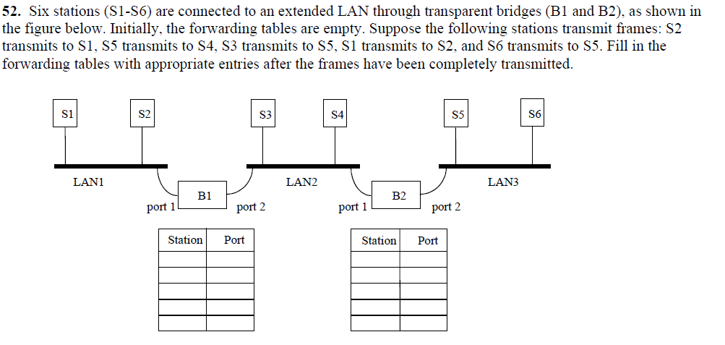

Slide 17
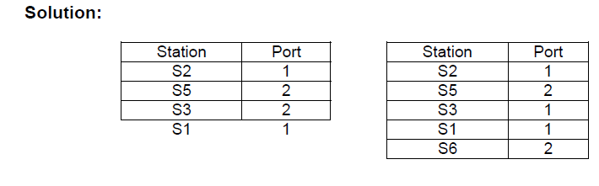


Slide 18
Loops in the Network
LAN1
B1
B2
B3
LAN2
B4
LAN3
B5
LAN4

Slide 19
Spanning Tree
The learning process described works as long as the network doesn’t contain loops, which means only one path exists between the two LANs
To remove loops in the network, the IEEE 802.1 committee came up with an algorithm called as spanning tree
The spanning tree algorithm requires every bridge to have a unique ID, each port within a bridge to have a unique port ID and all bridges on the LAN to have a MAC address

Slide 20

Avoiding Loops
LAN1
(1)
(1)
B1
B2
(2)
B3
LAN2
B4
LAN3
B5
LAN4

Slide 21
Spanning Tree Algorithm
Select a root bridge among all the bridges.
root bridge = the lowest bridge ID.
Determine the root port for each bridge except the root bridge
root port = port with the least-cost path to the root bridge
Select a designated bridge for each LAN
designated bridge = bridge has least-cost path from the LAN to the root bridge.
designated port connects the LAN and the designated bridge
All root ports and all designated ports are placed into a “forwarding” state. These are the only ports that are allowed to forward frames. The other ports are placed into a “blocking” state.

Slide 22
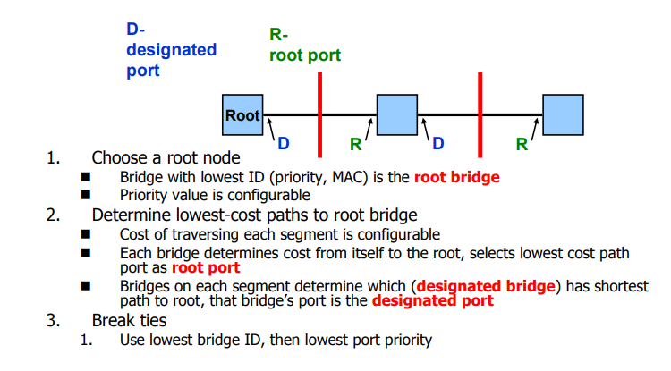


Slide 23
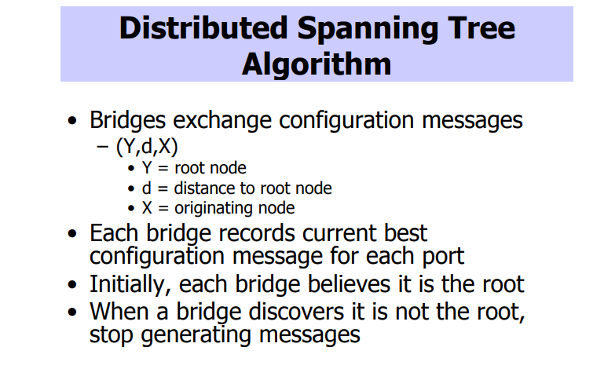


Slide 24
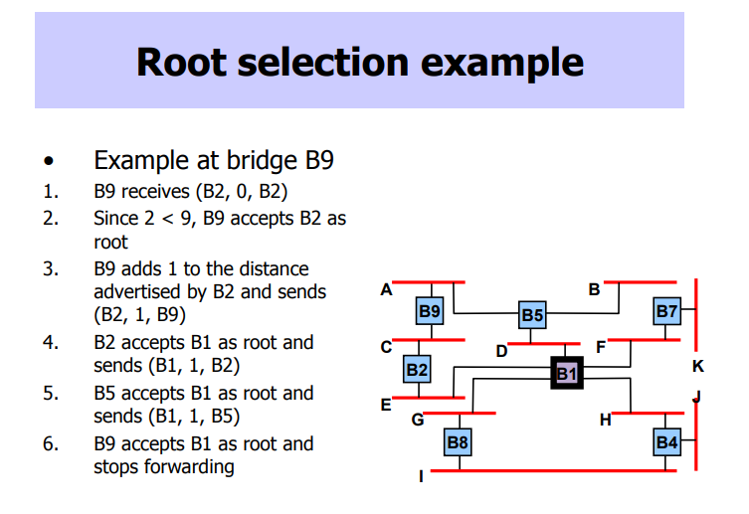
Notes:
Implementation of spanning tree – configuration brigde protocol data units(BPDUs).
BPDUs – transmitting brigde id, root bridge id and cost of least cost path.
Better configuration BPDU.

Slide 25
LAN1
(1)
(1)
B1
B2
(1)
(2)
(2)
(3)
B3
LAN2
(1)
(2)
B4
(2)
LAN3
(1)
B5
(2)
LAN4

Slide 26
LAN1
(1)
(1)
Bridge 1 selected as root bridge
B1
B2
(1)
(2)
(2)
(3)
B3
LAN2
(1)
(2)
B4
(2)
LAN3
(1)
B5
(2)
LAN4

Slide 27

LAN1
(1)
R
(1)
Root port selected for every bridge except root port
B1
B2
R
(1)
(2)
(2)
(3)
B3
LAN2
R
(1)
(2)
B4
(2)
LAN3
R
(1)
B5
(2)
LAN4

Slide 28

LAN1
D
(1)
R
(1)
Select designated bridge for each LAN
B1
B2
R
(1)
D
(2)
(2)
(3)
B3
LAN2
R
(1)
(2)
D
D
B4
(2)
LAN3
R
(1)
B5
(2)
LAN4

Slide 29
LAN1
D
(1)
R
(1)
All root ports & designated ports put in forwarding state
B1
B2
R
(1)
D
(2)
(2)
(3)
B3
LAN2
R
(1)
(2)
D
D
B4
(2)
LAN3
R
(1)
B5
(2)
LAN4
Notes:
Implementation of spanning tree – configuration brigde protocol data units(BPDUs).
BPDUs – transmitting brigde id, root bridge id and cost of least cost path.
Better configuration BPDU.

Slide 30
Adaptive Learning
In a static network, tables eventually store all addresses & learning stops
In practice, stations are added & moved all the time
Introduce timer (minutes) to age each entry & force it to be relearned periodically
If frame arrives on port that differs from frame address & port in table, update immediately

Slide 31
Source Routing Bridges
To interconnect IEEE 802.5 token ring networks
Each source station determines route to destination
Routing information inserted in frame if and only if the two stations are on different LANs
The routing control field defines the type of the frame, the length of the routing information, the direction of route (i.e. L2R or R2L) and the largest frame supported by the path
The route designator contains a 12 bit LAN number and a 4 bit bridge number.
Routing
Route 1
Route 2
Route m
control
designator
designator
designator
2 bytes
2 bytes
2 bytes
2 bytes
Destination
Source
Routing
Data
FCS
address
address
information
Notes:
Presence of routing information field is indicated by I/G bit source address field. 1= present. 0 indicates dest is in the same LAN.

Slide 32
Route Discovery
To discover route to a destination each station broadcasts a single-route broadcast frame
Frame visits every LAN once & eventually reaches destination
Destination sends all-routes broadcast frame which generates all routes back to source
Source collects routes & picks best

Slide 33

Detailed Route Discovery
Bridges must be configured to form a spanning tree
Source sends single-route frame without route designator field
Bridges in first LAN add incoming LAN #, its bridge #, outgoing LAN # into frame & forwards frame
Each subsequent bridge attaches its bridge # and outgoing LAN #
Eventually, one single-route frame arrives at destination
When destination receives single-route broadcast frame it responds with all-routes broadcast frame with no route designator field
Bridge at first hop inserts incoming LAN #, its bridge #, and outgoing LAN # and forwards to outgoing LAN
Subsequent bridges insert their bridge # and outgoing LAN # and forward
Before forwarding bridge checks to see if outgoing LAN already in designator field
Source eventually receives all routes to destination station

Slide 34

Discover the route from S1 to S3 using source routing bridges
Assume B1, B3, B4, B6 are part of spanning tree
LAN 2
B4
LAN 4
S1
B1
S2
LAN 1
B3
B5
B7
B2
S3
LAN 3
B6
LAN 5

Slide 35

Find routes from S1 to S3
LAN 2
B4
LAN 4
S1
B1
S2
LAN 1
B5
B3
B7
B2
S3
LAN 3
B6
LAN 5
Assume B1, B3, B4, B6 are part of spanning tree
B3
LAN3
B6
LAN5
LAN1
B1
LAN2
B4
LAN4

Slide 36
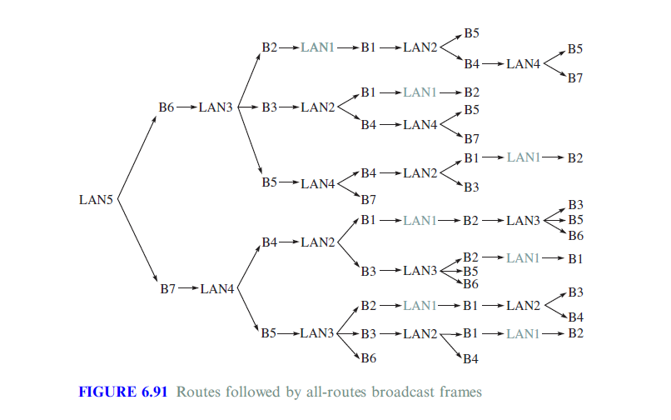

LAN 2
B4
LAN 4
S1
B1
S2
LAN 1
B3
B5
B7
B2
S3
LAN 3
B6
LAN 5
B3

Slide 37
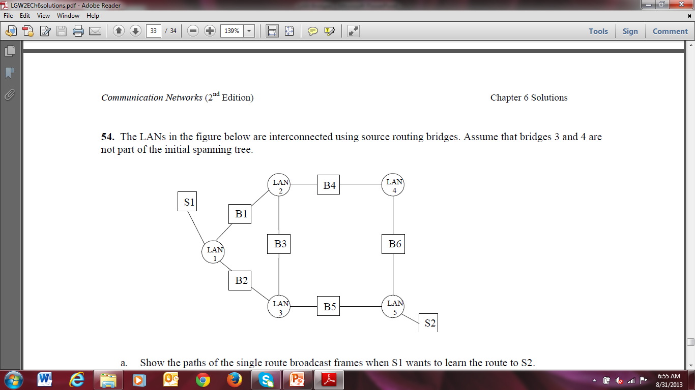
Five LANs are connected using source routing bridges. Assume that the bridges 3 and 4 are not part of the initial spanning tree. 1. show the single route broadcast frames when S1 wants to learn the route to S2 2. Show the path to all routes broadcast frames returned by S2. 3.List all possible routes from S1 to S2 from part (2) 4. How many LAN frames are required to learn the possible routes

Slide 38
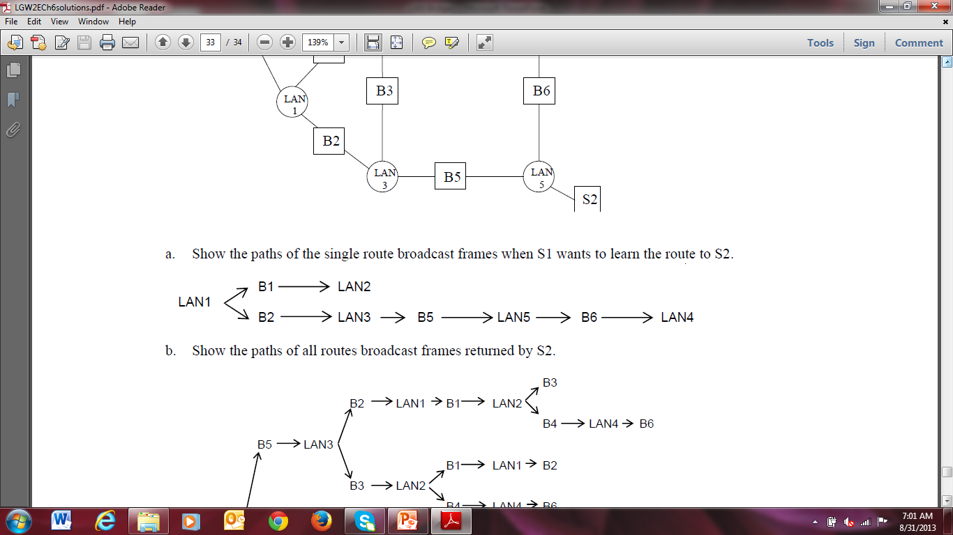

Slide 39
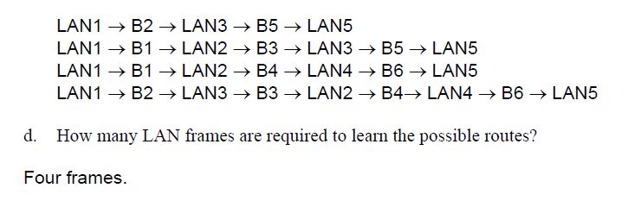

Slide 40
